Slide 1

City Manager’s Proposed FY 2024-25 Budget
Presented to the City Council on July 27, 2024
FY 2024-25 Budget

Slide 2
Presentation Overview
Budget Process Overview and Strategic Plan
Key Budget Initiatives and Focus Areas
Proposed Fund Financials For FY 2024-25
Proposed CIP Spending Plan
Next Steps
City Council Budget Options
FY 2024-25 Budget

Slide 3
Budget Process Overview & Strategic Plan
FY 2024-25 Budget

Slide 4
Transparent & Citizen Focused Process
February 9-10, 2024
City Council Visioning Workshop
February 20, 2024
Building Inspection Analysis & Staffing Recommendations
Street Pavement Analysis & Maintenance Funding Options
April 16, 2024
​​​​​​Community Survey Results
May 22, 2024
City's Strategic Plan
Customer Service Plan
Library Services Budget
City's Fleet & Fuel Operations
June 4, 2024
Compensation & Benefits Plan
June 8, 2024
Property Tax Rates & Debt Defeasance
Parks & Recreation Budget & 5-Year CIP
Holiday Lighting Program
July 2, 2024
City's Facilities Master Plan
Water Utilities & Public Works Proposed Budget Overview with 5-Year CIP Streets Maintenance with 5-Year CIP
July 16, 2024
Police Staffing Analysis
Police Budget Overview
All Other Funds Overview
Debt Obligations Overview
Discussion of Proposed Sportsplex Bond Proposition
Saturday, July 27, 2024
City Manager's Presentation of Proposed Budget for FY 2024-2025
City Fees & Charges Overview
August 6, 2024
Performance Measurement & Lean Government Initiatives
Water & Wastewater Cost of Service Study & Rates
Property Tax Rate
August 20, 2024
Eco Dev Master Plan
Public Hearing - Budget, Fees, Utility Rates, & Property Tax Rates
1st Readings to approve Budget & Tax Rate
September 3, 2024
City's Strategic Plan
Public Hearing - Budget, Fees, Utility Rates, & Property Tax Rates
Final Readings to approve Budget & Tax Rate
FY 2024-25 Budget
Notes:
We need to add section related to the July 16th meeting. The below topics will be discussed:
*Matrix Staffing Analysis for the Police Department
*Police Department Budget Recommendations
*City-wide Debt Analysis and Projections
*Discussion of Proposed Sportsplex Bond Proposition

Slide 5
Community Survey Results
73%
of 634 surveyed residents are
satisfied with life in Kyle
FY 2024-25 Budget

Slide 6
Community Survey Results
FY 2024-25 Budget

Slide 7
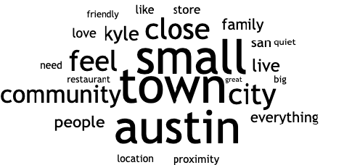
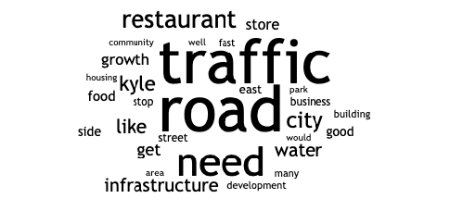
Community Survey Results
What Residents Love
Question: What is your favorite thing about living in Kyle?
What Residents Want Changed
Question: What is the one thing you would change in Kyle?
FY 2024-25 Budget

Slide 8
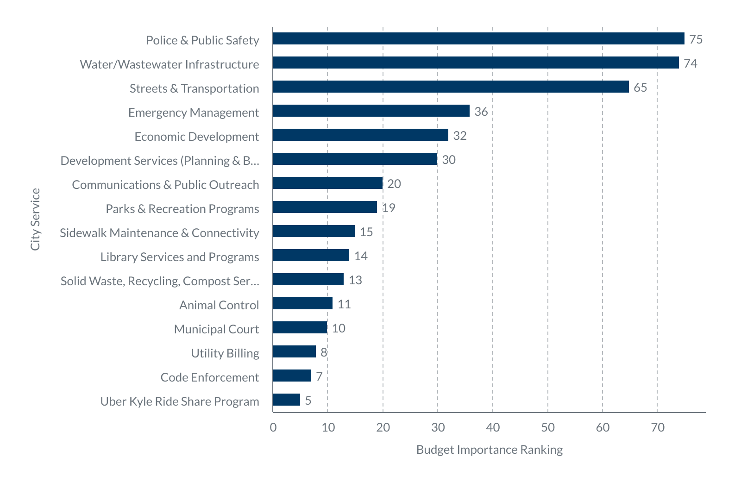
2024 Budget Survey Results
275 Residents Responded between July 1-22
Top 5 Priorities for Residents​:
1. Police & Public Safety​
2. Water/Wastewater Infrastructure​
3. Streets & Transportation​
4. Emergency Management​
5. Economic Development​
FY 2024-25 Budget
Notes:
I would like to also outline the outreach process and number of responses that we received.

Slide 9
Strategic Plan Development
In coordination with this year’s budget process, staff is proposing the first ever city-wide strategic plan.
  Incorporates community, council and staff feedback received over the past several months.
  Key strategic outcomes and goals identified by Council during visioning workshop meetings in February.
    Hired outside facilitator to guide key discussions and develop consensus.
  Executive staff also held a retreat with facilitator in April to develop key goals and objectives based on Council priorities.
Draft plan is included as an exhibit to this item, and Council will be asked to formally adopt plan at the same time as the budget itself in September.
Strategic Plan is critical to properly match goals with spending priorities over time.
  Budget should be a reflection of goals to ensure they are achieved over time.
  For context, the proposed budget and CIP contemplates approximately $1.6 Billion in expenditures over the next five years.
FY 2024-25 Budget

Slide 10
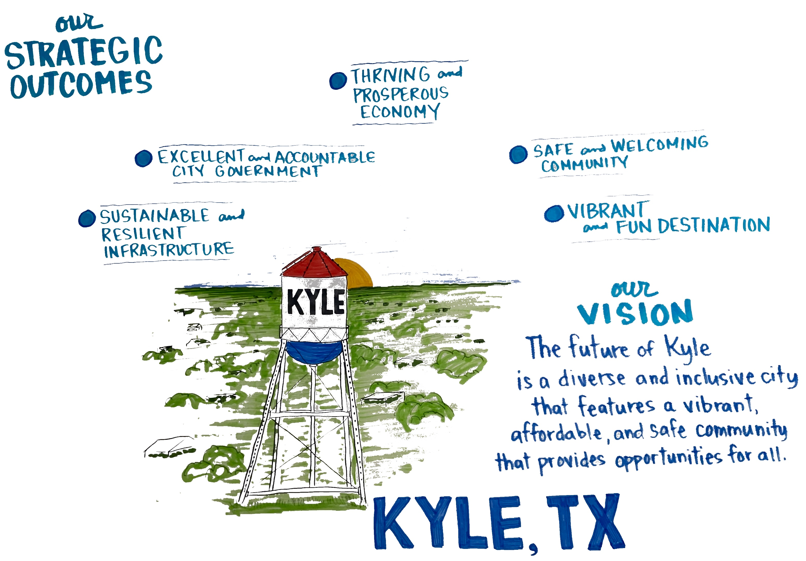
FY 2024-25 Budget

Slide 11
Budgeting for Outcomes
Based on the outcomes identified, the Strategic Plan details objectives and tasks to be completed.
  Tasks with timelines are identified to be completed.
  Items are assigned to specific departments to provide ownership and accountability.
  The plan includes over 65 major items to be completed next year.
  Each Department will be asked in 2025 to create a Strategic Plan that ties into the city’s overall strategic plan.
Key items for the plan over the next year include.
  Design and Construction of a new Sportsplex
  Creation of new Parks, and reinvestment in current park system
  Design and construction of various key water and wastewater projects
  Construction of the voter approved road bond program and various transportation initiatives
  Enhancement of Customer Service through 311 system
  Improvement of operational efficiency through lean government and performance management
FY 2024-25 Budget

Slide 12
Key Budget Initiatives & Focus Areas
FY 2024-25 Budget

Slide 13
Budget Focus Areas
Operational Improvements & Cost Containment Initiatives
Organizational
Excellence & Strategic Service Delivery
Water & Wastewater Utilities
Streets, Transportation & Drainage
Enhanced
Public Safety
Park Development & Improvements
FY 2024-25 Budget

Slide 14
Operational Improvements & Cost Containment Initiatives
FY 2024-25 Budget

Slide 15
Operational Improvements Implemented
Created strong business team focused on customer services and accountability.
Improved City Council Agenda Management System & Process
  Implemented new electronic agenda management system.
  Increased transparency of agenda materials for both the council and the public.
  Standardized workflow review and approval processes to improve efficiency.
Enhanced Community Engagement and Transparency
  Quarterly Newsletter mailed to every address
  Weekly Friday Reports Posted Online
  Responses to Open Records Request are displayed to public on website (GovQA)
Created Centralized Purchasing Function
  Centralized the city's procurement and contract management processes to ensure compliance and efficiency.
  In the past, purchasing was decentralized which led to inconsistent processes across the organization and ineffective contract management.
FY 2024-25 Budget

Slide 16
Operational Improvements Planned
Creation of new 311 customer service center by March 2025
  Improve customer service experience and increase access to services for residents.
  Centralize customer requests from a variety of platforms (e.g. phone, email, app, etc.).
  Data will drive performance improvement and better outcomes.
Launch of Lean Government Initiative
  Formalizes process to systematically review operations and make improvements that increase operational efficiency and cost effectiveness.
  Presentation detailing this new program will be outlined on August 6th.
Development of Performance Management and Open Data program
  Link strategic plan vision, strategic focus, objectives, action items, and key performance indicators (KPIs).
  City Council approved contracts for new performance management software solution in April 2024.
  Program expected to ”go live” this fall.
FY 2024-25 Budget

Slide 17
Cost Containment Initiatives
Evaluated building inspection processes and proposed in house inspection program.
  Proposed changes will yield approximately $1.7 million in annual savings.
Completed benchmarking analysis and recommended new development services rate structure to offset actual costs incurred and better align with our peer cities.
  Fee changes will generate approximately $1.75 million in additional revenue on an annual basis.
Improved Utility Billing Operations.
  Increased customer service standards.
  Updated policies and created data driven performance metrics to assess efficiency.
  Increased collection rate to 99+% resulting in an additional $2.5 million in Water and Wastewater revenue each year.
Began implementation of a new electronic time and attendance system
  Significant cost savings and productivity improvements will result from transitioning from a mostly manual process to an automated software system.
FY 2024-25 Budget

Slide 18
Cost Containment Initiatives
Reviewed operations, increased efficiency, and proposed the net elimination of 10 FTEs.
  Eliminated Assistant City Manager, Director of Public Works and Director of Human Resources positions to reduce costs by $866,712 per year.
  Proposed creation of new 311 service and centralized procurement, payroll, and call taking operations across the city.
    Removes siloed and inefficient service model.
    Eliminates 7 FTEs across the organization.
    Reduces annual costs by $589,531 and realizes a soft cost savings to Water Utilities of $287,099.
In total, the proposed reduction in positions represents a $1,456,243 annual cost savings to the city.
FY 2024-25 Budget

Slide 19
Cost Containment Initiatives
Created new legislative program and applied for over $100 million in grant funding.
  Developed comprehensive grants tracking portal to monitor legislative contacts, grants, and projects.
  Aggressively pursued advocacy efforts with legislative partners.
Prepared new water and wastewater impact fee study and recommended to Council fee increases to cover a larger share of our costs.
  These fee increases are expected to generate an additional $6.2 Million in revenue for FY 2024-25.
Combined cost containment initiatives proposed in the coming budget generate approximately $13.61 Million in annual cost reductions and increased revenues.
FY 2024-25 Budget

Slide 20
Organizational Excellence & Strategic Service Delivery
FY 2024-25 Budget

Slide 21
Organizational Excellence
Assessing Overall Efficiency
FY 2024-25 Budget
Notes:
Andy will check if Jacob can grab these

Slide 22
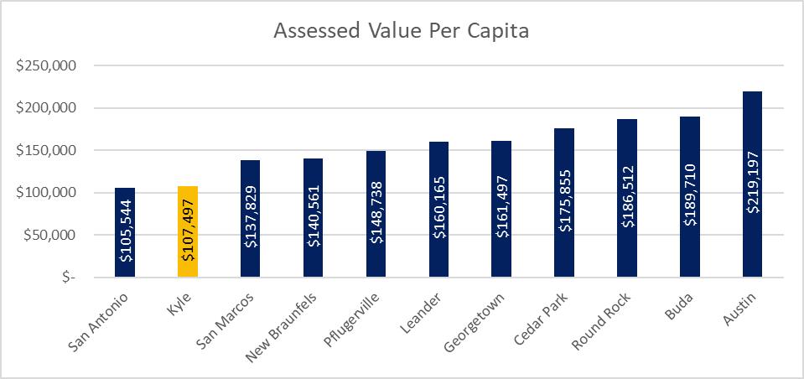
Assessed Value Per Capita
* Based on 2023 Values
Notes:
Andy will check if Jacob can grab these

Slide 23
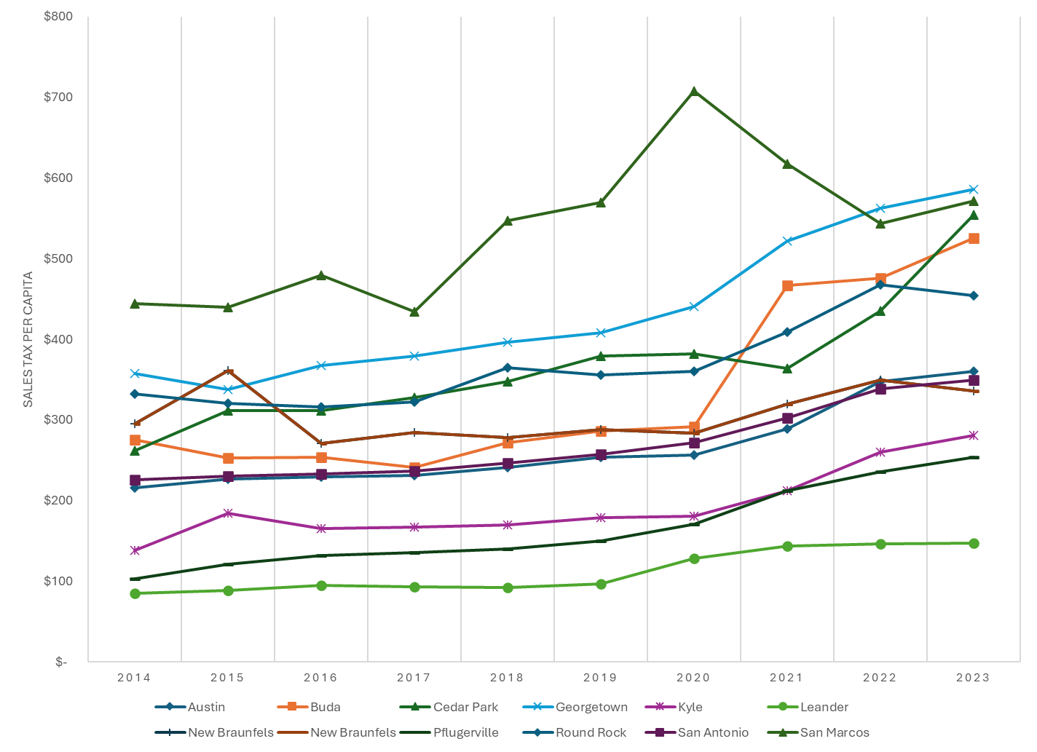
Sales Tax Per Capita
FY 2024-25 Budget
Notes:
Andy will check if Jacob can grab these

Slide 24
Market-Based Employee Compensation, Benefits Program
Organizational Excellence
Employee
Compensation
Competitive compensation philosophy
Peer comparisons and job benchmarks
New salary guide structure with paygrades of job families/job groups
Other compensation pay or incentive(s) to assist in recruiting
4.5% merit increase budgeted
10 Peer Cities to Target in the Corridor
Austin
Buda
Cedar Park
Georgetown
Leander
New Braunfels
Pflugerville
Round Rock
San Antonio
San Marcos
Recruiting of qualified and talented candidates to provide Gold Standard service and expertise to our citizens.
Increase Career Progression
Opportunities
Offer career progression opportunities within job families.
Be Employer of Choice by offering:
  Great Pay
  Great Benefits
  Great Culture
  Great Projects
FY 2024-25 Budget

Slide 25
Market-Based Employee Compensation, Benefits Program
Organizational Excellence
4.5% Merit Increases - $967,000 (All funds)
Police Step Increase Year 3 - $387,086 per meet and confer contract.
Proposing $450,000 to elevate Police sworn positions to a more competitive position.
  Goal will be to remain in the top 25% of comparison cities.
Citywide equity adjustments will be made upon completion of the pay study.
457 Deferred Compensation Plan Review - $25,000
FY 2024-25 Budget

Slide 26
Police Sworn Salary Analysis
Position | Entry Salary Compared to Market Cities 10/1/23 | Entry Salary Compared to Market Cities 10/1/24
Police Officer | 8th out of 11 | 3rd out of 11
Police Corporal | 7th out of 11 | 5th out of 11
Police Sergeant | 11th out of 11 | 8th out of 11
Police Commander | 11th out of 11 | 11th out of 11
*Comparisons are based on published peer city step plans and salaries recommended in the proposed budget.
FY 2024-25 Budget
Notes:
Andy will check if Jacob can grab these

Slide 27
Strategic Efforts Completed
To properly plan for the future, the following items were completed this past year to guide decision making:
  Police staffing analysis
  Pay and compensation study
  Water and Wastewater Impact Fee Study
  Pavement Condition Analysis and Assessment
  Reclaimed Water Master Plan
  Adoption of new Comprehensive Plan
  Cost of Service Study for Water and Wastewater Rates
FY 2024-25 Budget

Slide 28
Future Strategic Items
Additionally, the following items are planned for the coming year.
  Water and Wastewater Master Plan ($1.25 million)
  Parks Master Plan ($250,000)
  Transportation Master Plan ($400,000)
  Street Impact Fee (ALM) Study ($50,000)
  Master Facility Plan ($100,000)
  Assessment of Fleet and Fueling Operations ($150,000)
  Development of a formal indirect cost allocation plan ($150,000)
  Storm Water Drainage Fee Study ($150,000)
  City-Wide Risk Assessment Analysis ($150,000)
  Development Code Re-write ($500,000)
FY 2024-25 Budget

Slide 29
Water & Wastewater Utilities
FY 2024-25 Budget

Slide 30
Water & Wastewater Utilities
Major Initiatives Underway & Proposed
Water Master Plan – Completion in early 2025
  Strategic Investment in Indirect/Direct Potable Reuse
  Examining other water supply options
Funding a Wastewater Master Plan in FY 2025 - $750K
Pursuing TCEQ Permit for WWTP Expansion (9 MGD)
Alliance Regional Water Construction:
  Phase 1B delivered in February 2025
  Looking for opportunities to increase ARWA supply in 2027
Considering Strategic deployment of reclaimed water for parks
  $2 million included in FY2025 Budget
Increase budget for wastewater line repair, replacement, and slip lining.
  $2.5 million included in FY2025 Budget to reduce I&I
FY 2024-25 Budget

Slide 31

Water & Wastewater Utilities
Planned Short-Term Supply
Planned Short-Term Supply
10
9
Million Gallons per Day (MGD)
Total Base Supply
San Marcos Interconnect Agreement
San Marcos EAA Agreement ARWA Phase 1B Supply ARWA Phase 1C/1D Supply
Demand Projections (MGD)
Demand Projections with Restrictions (MGD)
8
8.34
7
7.58
6.89
6.59
6
6.27
5.99
5
5.18
4.09
5.70
5.45
4.50
4.95
4
3
*Preliminary forecasts are based on 2025 Water Master Plan and are subject to change
2
1
0
2023
2024
2025
2026
2027
2028
Year

Slide 32
Water & Wastewater Utilities
Recommended Staffing Additions FY 2025
Water/Wastewater
Wastewater Tech I (2)
Division Manager, W/WW Maintenance (1)
Lead Licensed Electrician (1)
Lead Lift Station Technician (1)
Lift Station Technician (3)
Water Conservation Coordinator (1)
Backflow Technician (1)
Instrumentation Control Technician (1)
Water Crew Lead (1)
Assistant Director, Water Resources/Projects (1)
Water Tech I (3)
Management Assistant (2)
Total: 18
Public Works
Director of Transportation & Traffic (1)
Division Manager of Fleet Services (1)
Public Works Inspectors (3)
Building Maintenance Technician (1)
Facility Maintenance Specialist (2)
Total 8
Engineering
CIP Division Manager (1)
Land Acquisition Manager (1)
Land Acquisition Agent (1)
Project Manager (1)
Total: 4
KWU Total: 30 positions
FY 2024-25 Budget
FY 2024-25 Budget

Slide 33
Water & Wastewater Utilities
Recommended Equipment for FY 2025
Water/Wastewater
(3) Tank Mixing Systems - $120,000 ​
Six-inch Self Priming Pump - $50,000​
(4) Chlorine Analyzers - $21,740​
Confined Space Entry Equipment - $25,000 ​
Safety Shoring Equipment - $30,000​
Meter Bench Testing Machine - $30,000​
3 Cubic Yard Vactor Truck - $400,000​
4k gal Wastewater Vac Truck - $300,000​
Valve Maint. F550 Work Truck - $165,000
Public Works​
(6) Half-Ton Trucks - $69,600​​
(2) 16 Yard Dump Trucks - $365,000​​
(2) 550 Crew Cab Work Trucks - $38,400​​
(1) Tommy Lift Gate - $7,000​
Total Water Utilities Equipment $2,678,360 ​
FY 2024-25 Budget
FY 2024-25 Budget

Slide 34
Water & Wastewater Utilities
Major Initiatives Underway & Proposed
Water Utilities improvements funded for 5 Year CIP is $339.6 million; $99.6 million funded for FY2025; Projects Include:
  WWTP Access Road – $4.5M for FY2025, $4.5 million for 5 Year CIP
  WWTP Expansion PH II, 9.0 MGD - $6 million for FY2025, $101 million for 5 Year CIP
  Reclaimed Water Fill Station - $1 million for FY2025, $1.5 million for 5 Year CIP - $288,530 in expected sales
  Reclaimed Irrigation for Parks – $500,000 for FY2025, $2 million for 5 Year CIP
  Lehman Pump Station Expansion – $1.5 million for FY2025, $11 million for 5 Year CIP
  Water Facilities Fence Replacement and Upgrades - $150,000 for FY2025, $3.2 for 5 Year CIP
  Water Utilities Offices Land Acquisition - $5 million for FY2025, $30 million for 5 Year
  ARWA 3rd Take Point - $5 million for FY2025, $40 million for 5 Year CIP
  Supervisory Control and Data Acquisition (SCADA) Upgrades - $500 thousand for FY 2025, $1 million for 5 Year CIP
FY 2024-25 Budget

Slide 35
Water & Wastewater Utilities
Cost of Service & Rate
On February 26, 2024, the City Council approved a contract with Raftelis Financial Consultants, Inc., to conduct a cost of service & rate study for the City's water and wastewater utilities.
﻿﻿To date, the cost of service study is approximately 75% complete.
﻿﻿﻿﻿Preliminary results of the study determined that residential rate payers are paying more than their proportional share as compared to commercial customers.
While rate increases for both water and wastewater services are expected, the rate study calls for a smaller increase for residential customers and shifting the rates proportionately to commercial rate payers.
The study results will be presented to the City Council on August 6, 2024 for consideration and for decision on rate options.
FY 2024-25 Budget
FY 2024-25 Budget

Slide 36
Streets, Drainage
& Transportation Improvements
FY 2024-25 Budget

Slide 37
Transportation & Drainage Infrastructure
Major Initiatives Underway & Proposed
Continued Construction of 2022 Voter Authorized Road Bond Program
  $232 million in planned expenses over the 5 Year CIP
  Marketplace is expected to be under construction by Oct 2024/ Completion in April 2025
  Kohlers Crossing, Windy Hill, and Stagecoach expected to begin construction 2025
Kohlers Roundabouts (3) – at Benner, Sanders and Cromwell
  $15 million included for FY 2025 construction
Intersection Improvements planned in FY 2025:
  Marketplace @ Kohlers - $1.5 million design funding in FY 2025, total project budget of $7.5 million
  Kohlers @ Kyle Crossing - $1.5 million design funding in FY 2025, total project budget of $7.5 million
  FM 1626 @ Marketplace - $1.5 million design funding in FY 2025, total project budget of $7.5 million
  Marketplace @ Kyle Center $1 million design funding in FY 2025, total project budget of $5 million
  Stagecoach @ Veterans - $1.2 million design funding in FY 2025, total project budget of $6 million
Expansion of TIRZ #4 to provide funding for Goforth Road Project
Transportation Master Plan - $400,000
Roundabout and Corridor Beautification - $1 million in FY2025, $5 million over 5 years
FY 2024-25 Budget

Slide 38
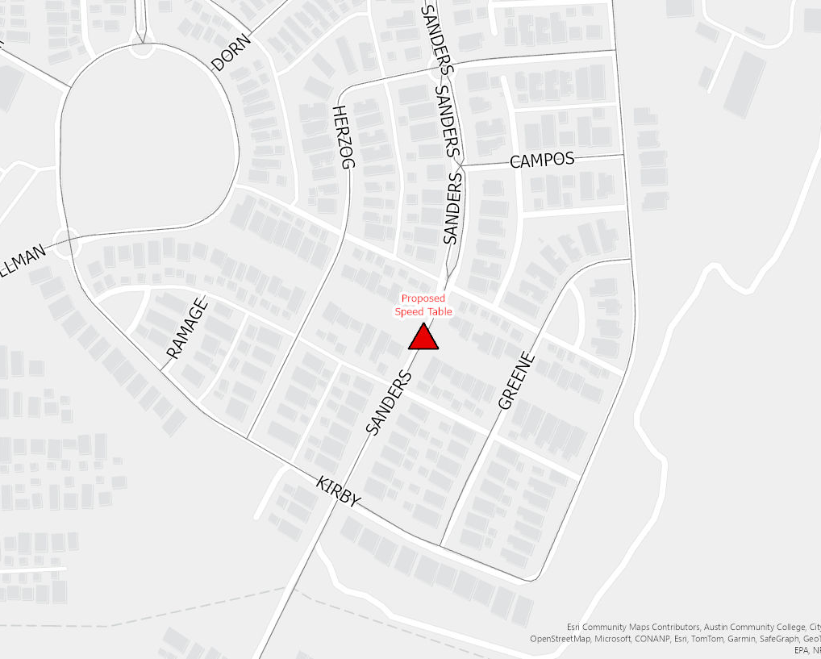
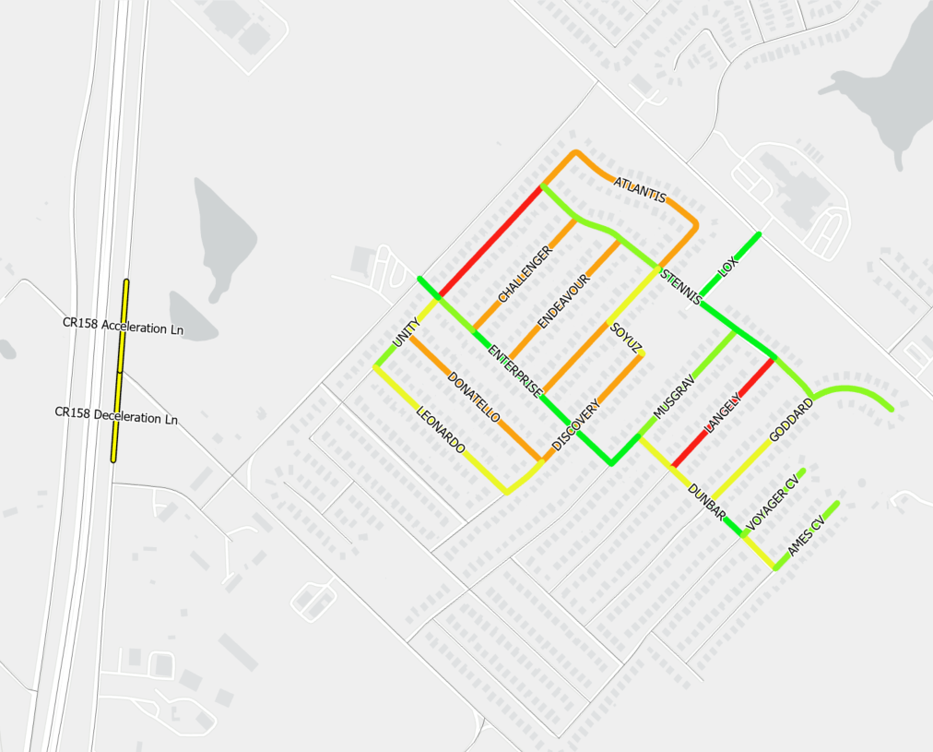
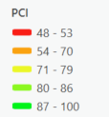
Transportation & Drainage Infrastructure
Major Initiatives Underway & Proposed
Plum Creek Traffic Calming (Sanders) - $200k
Post Oak Subdivision Road Preservation – $400k
CR 158 Acceleration and Deceleration Lane Improvements - $600k
FY 2024-25 Budget
29

Slide 39
Transportation & Drainage Infrastructure
Major Initiatives Underway & Proposed
Pavement Study Completed in 2024
  PCI of 82.5 is recommended.
  Street Maintenance funding has been increased from $1.5 million to $2.88 million to maintain streets at this level.
Sidewalk and Vybe Master Plan
  $200,000 annually for sidewalk gap program inception
  $266,144 included in CDBG funds for sidewalks
  $650,000 included for Vybe Trails in FY 2025; $1 million in funding each year afterwards in CIP
New Transportation Director Position ($273,134)
  Will provide organizational oversight over all transportation projects
  Responsible for development of Intelligent Transportation System
FY 2024-25 Budget

Slide 40
Transportation & Drainage Infrastructure Projects Planned for FY 2025
Full Depth Repair 12" Black Base and 2" Surface
LOCATION | FROM | TO | LANE MILES | COST
Creekside Trail Phase II | End of Phase I | Dead End | .50 | $322,924
East Post Road | IH 35 | Hays County | .65 | $279,411
 |  | TOTAL | 1.15 | $602,335
FY 2024-25 Budget

Slide 41
Transportation & Drainage Infrastructure Projects Planned for FY 2025
Chip Seal
LOCATION | FROM | TO | LANE MILES | COST
Lockhart St | Burleson St | Wallace St | .54 | $2,057
Groos St | W Center St | Blanco St | .23 | $1,136
N Sledge St | W Center St | W Lockhart St | .23 | $1,180
Austin St | N Nance St | N Front St | .34 | $1,623
Cockerham St | Veterans Dr | Dead End | .38 | $2,408
W Schlemer St | Live Oak St | Dead End | .72 | $4,103
W North St | Dead End | Dead End | .46 | $2,434
 |  | TOTAL | 2.90 | $14,941
FY 2024-25 Budget

Slide 42
Transportation & Drainage Infrastructure
Projects Planned for FY 2025
2" Mill and Overlay
LOCATION | FROM | TO | LANE MILES | COST
N Main St | W Center St | W North | .64 | $49,825
S Main St | Miller St | W Center St | .11 | $8,846
N Meyer St | W Center St | Live Oak St | .55 | $42,915
Barber St | Veterans Dr | Blanco St | .17 | $13,283
Wallace St | W Center St | Live Oak St | .37 | $28,395
Wood St | Barber St | Wallace St | .09 | $6,964
Porter St | Veterans Dr | Live Oak St | .48 | $37,026
S Old Stagecoach | Conestoga Dr | W Center St | .79 | $61,052
Salado Dr | San Felipe Dr | Star of Texas Dr | .60 | $46,425
Star of Texas Dr | Burleson Dr | Hunter Dr | .70 | $54,247
Quail Ridge Dr | E Post Rd | E Post Rd | 2.81 | $180,968
FY 2024-25 Budget

Slide 43
Transportation & Drainage Infrastructure
Projects Planned for FY 2025
2" Mill and Overlay
LOCATION | FROM | TO | LANE MILES | COST
Rodeo Cv | Star of Texas | Cul de Sac | .14 | $10,725
Briar Wood Ct | Spring Branch Dr | Cul de Sac | .23 | $18,077
Amherst Ct | Spring Branch Dr | Cul de Sac | .25 | $19,157
Cisneros St | W Center St | Dead End | .19 | $14,755
Saucedo St | W Center St | Dead End | .15 | $11,616
Ramirez St | W Center St | Dead End | .17 | $12,848
Onyx Lake Dr | Pearl Lake Dr | Dead End | .82 | $63,360
Agate Lake Dr | Onyx Lake | Cul de Sac | .13 | $9,933
Jade Lake Cv | Cul de Sac | Dead End | .14 | $11,121
Ruby Lake Dr | Loon Lake Dr | Onyx Lake Dr | .41 | $31,746
Creekside Tr Phase I | FM 150 | 995 Ft North | .47 | $34,000
FY 2024-25 Budget

Slide 44
Transportation & Drainage Infrastructure
Projects Planned for FY 2025
2" Mill and Overlay
LOCATION | FROM | TO | LANE MILES | COST
Pearl Lake Dr | Loon Lake Dr | Dead End | .46 | $35,970
Opal Lake Dr | Ruby Lake Dr | Pearl Lake Dr | .31 | $23,892
Mood Lake Dr | Ruby Lake Dr | Dead End | .37 | $28,512
Loon Lake Dr | Mansfield Lake Trl | Cul de Sac | .64 | $49,764
Mansfield Lake Trl | Lake Washington Dr | Dead End | .20 | $15,642
Town Lake Bend | Lake Washington Dr | Loon Lake Dr | .13 | $10,230
Carriage Way | Goldenrod St | Goldenrod St | .88 | $68,068
Goldenrod St | Bluestem St | Wagon Cross | .66 | $51,067
Zebra Dr | Bunny Trail | Dead End | .57 | $44,425
Wild Buffalo Dr | Fairfield Dr | Primrose Blvd | .53 | $40,803
 |  | TOTAL | 15.16 | $1,135,657
FY 2024-25 Budget

Slide 45
Transportation & Drainage Infrastructure
Projects Planned for FY 2025
Total Cost for All Projects
PROJECT TYPE | LANE MILES | COST
Full Depth Repair | 1.2 | $602,335
Chip Seal | 3.0 | $14,941
2" Mill and Overlay | 15.0 | $1,135,657
Microsurfacing | 15 | $1,127,067
Total | 34.2 | $2,880,000
FY 2024-25 Budget

Slide 46
Transportation & Drainage Infrastructure
Projects Planned for FY 2025 & 5 Year CIP
Drainage improvements funded for 5 Year CIP is $13.2 million; $2.8 million funded for FY2025; Projects Include:
  Scott/Sledge drainage improvements – $300,000 for FY2025, $2.7 million for 5 Year CIP
  S. Goforth drainage improvement - $2 million for FY2025 pending development agreement
  Bunton Ln drainage improvements – $0 for FY2025, $1.5 million for 5 Year CIP
  Plum Creek Channel Improvements – $0 for FY2025, $4.5 million for 5 Year CIP
  Drainage Master Plan/Improvements - $500,000 for FY2025, $2.5 million for 5 Year CIP
  Drainage Fee Study - $150,000
    Proposed to calculate appropriate fee to fund identified projects in the City's Drainage Master Plan
    Last fee update was over 5 years ago
    Fee should be based on identified projects in the Master Plan
FY 2024-25 Budget

Slide 47
Enhanced Public Safety
FY 2024-25 Budget

Slide 48
Enhanced Public Safety
Police Staffing Study
Police Staffing Study Key Points
Comprehensive overview of police calls and response levels and from that we have developed a series of recommendations to plan our resources over the next several years.
A total of 12 positions have been recommended for FY2025
FY 2024-25 Budget

Slide 49
Enhanced Public Safety
Recommended Personnel for FY 2025
Operations
7 Staff to meet service demands for the community, including:
(2) Police Corporals
(1) Police Safety Specialist
(2) Analyst - Real Time Crime Center
(1) Analyst CID
(1) Evidence Technician
Total FY2025: $675,357
Support Services
5 Staff to assist operations staff in performing their duties, including:
(1) Public Information & Community Engagement Specialist
(1) Patrol Secretary
(1) Training Coordinator
(1) Mental Health Civilian Responder
(1) Records Specialist
Total FY2025: $478,678
FY 2024-25 Budget

Slide 50
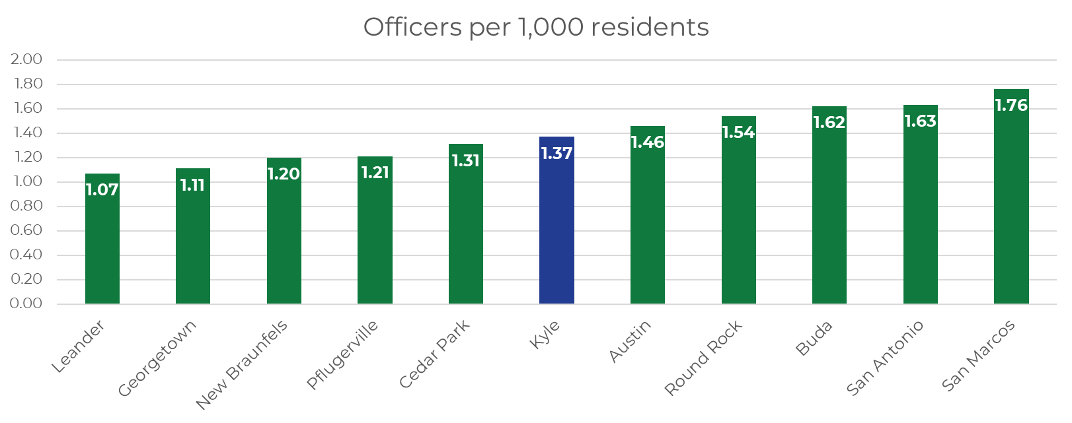
Enhanced Public Safety
Personnel
FY 2024-25 Budget
Notes:
Need to get updated numbers

Slide 51
Enhanced Public Safety
Equipment & Technology
New Leased Vehicles - $155,444 per year for 9 vehicles
Radio Equipment for patrol $173,000
Opticom Traffic Signal Preemption - $60,000
Drone Program for Patrol - $61,381
Safety Signs and Barricades - $208,553
FUSUS Software – $96,000
Other Software Support Items - $134,000
FY 2024-25 Budget

Slide 52
Park Development & Improvements
FY 2024-25 Budget

Slide 53
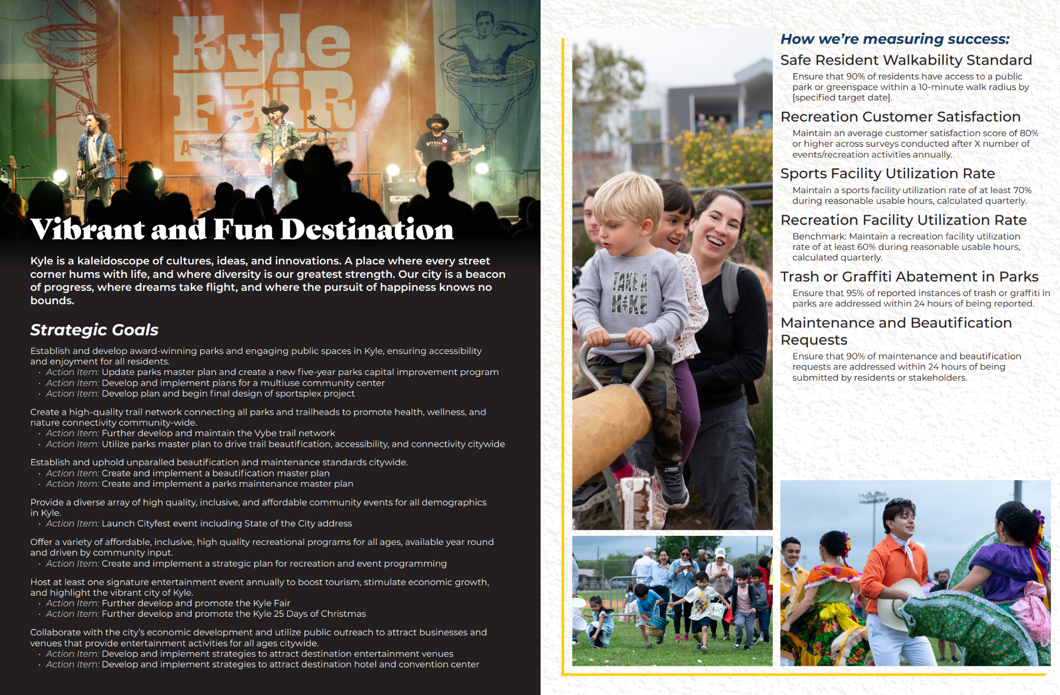
Park Development & Improvements
City Strategic Plan and Parks Master Plan
Clear Vision and Goals
Community Engagement
Policy Framework & Resource Allocation
Infrastructure Development
Community Partnerships
Key Strategic Goals
Award-Winning Parks & Public Spaces
High-Quality Trails & Connectivity
Unparalleled Beautification Standards
High-Quality, Diverse, and Inclusive Community Events
Affordable Recreation Programs for All Ages
Signature Entertainment Events Annually
Economic Impact and Draw
  Proposed Sportsplex will be discussed with Council at August 6.
FY 2024-25 Budget

Slide 54
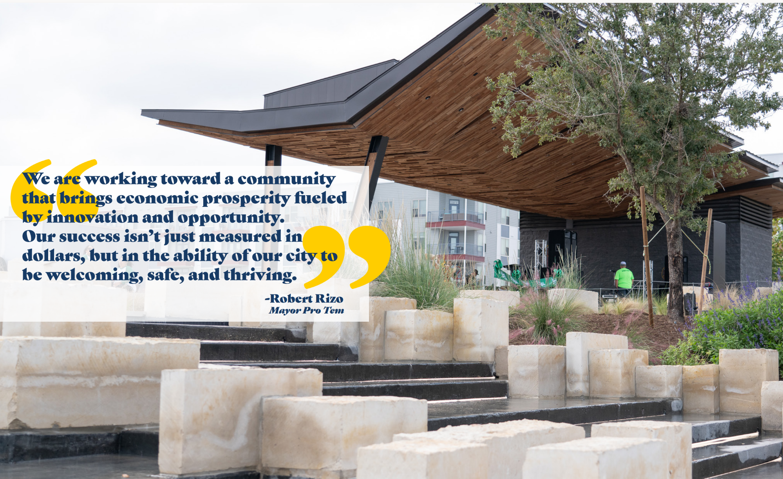
Park Development & Improvements
Parks and Recreation Budget Items
New Employee Staff - $151,684
  Recreational Specialist
  Management Assistant
Temporary Seasonal Wages - $100,000
Sports Leagues Costs - $125,000
Summer Camp Costs - $50,000
Program Expenses - $42,000
City Event Supplies - $35,000
Temporary Seasonal Wages - $90,000
New/Replacement Mowers (3) - $45,000
Bucket Truck (1) - $200,000
Future Evaluation Enhancements - $250,000
FY 2024-25 Budget

Slide 55
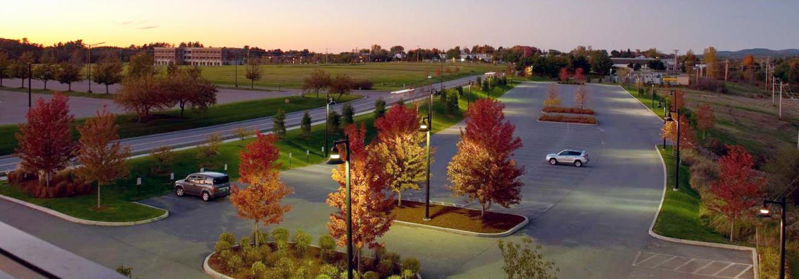
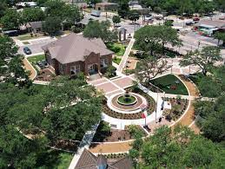
Park Development & Improvements
Major Parks Capital Projects Overview
Parking lot design and construction
  La Verde, Steeplechase, Waterleaf, Gregg-Clarke, Lake Kyle
Landscaping, lawn, irrigation, and planting
  La Verde, Steeplechase, Waterleaf, Gregg-Clarke, Bunton, Heroes Memorial
Restrooms and Amenity Care
  Heroes Memorial, Steeplechase, Waterleaf, Gregg-Clarke, Post Oak
Fencing, shade structures, and seating
  Steeplechase, Waterleaf, Gregg-Clarke, Post Oak
Lighting, security and internet functionality
  Steeplechase, Waterleaf, Bunton, Lake Kyle, Heroes Memorial, Post Oak
“Establish and develop award-winning parks and engaging public spaces in Kyle,
ensuring accessibility and enjoyment for all residents.”
“Establish and uphold unparalleled beautification and maintenance standards citywide.”
FY 2024-25 Budget

Slide 56
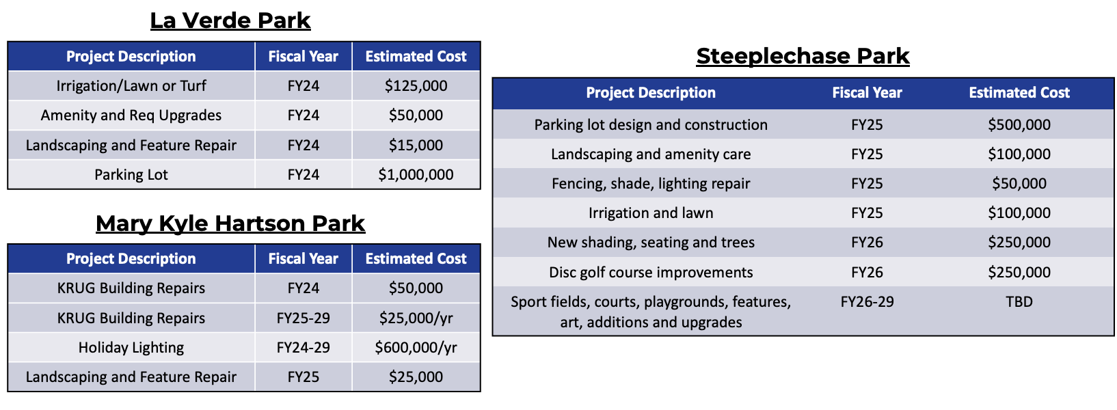
Park Development & Improvements
FY 2024-25 Budget

Slide 57
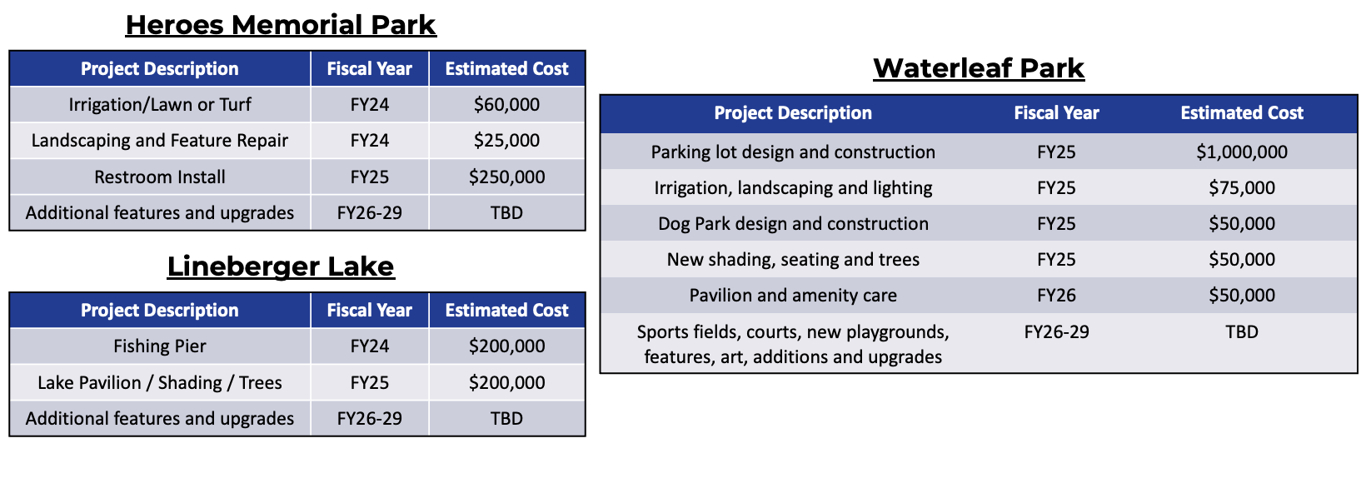
Park Development & Improvements
FY 2024-25 Budget

Slide 58
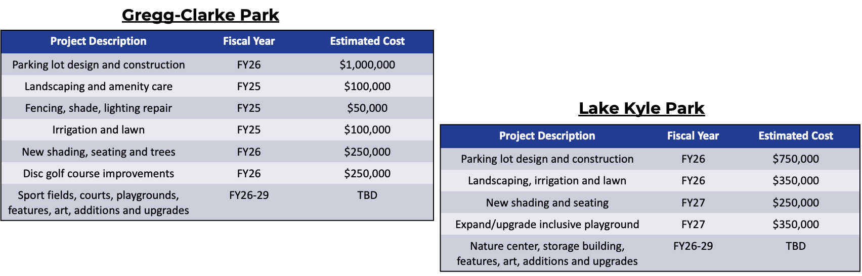
Park Development & Improvements
FY 2024-25 Budget

Slide 59
FUND FINANCIALS
Proposed Budget
Fiscal Year 2024-25
FY 2024-25 Proposed Budget

Slide 60
City’s Fund Structure

Slide 61
ALL CITY FUNDS
PROPOSED BUDGET FISCAL YEAR 2024-25
$365,400,812
FY 2024-25 Budget

Slide 62
BUDGET HIGHLIGHTS - ALL CITY FUNDS
PROPOSED BUDGET FISCAL YEAR 2024-25
Overall for All City Funds:
$365.4 million total proposed budget for all City Funds
$248.5 million in planned CIP spending in Fiscal Year 2025
54.0 new positions proposed for a total of 433.0 (net) positions
$0.4693 proposed property tax rate (awaiting certified tax rates from HCTAC)
  Current tax rate = $0.4693 per $100/AV
Rate increase (system-wide) projected for water service rates in FY 2025
  Rate increase will vary by customer class
Rate increase (system-wide) projected for wastewater service rates in FY 2025
  Rate increase will vary by customer class
No change in storm drainage fees
2.5% increase in solid waste service rates per contract terms with TDS

Slide 63
BUDGET HIGHLIGHTS – 54 NEW POSITIONS
PROPOSED BUDGET FISCAL YEAR 2024-25
Department | Position Title | FTE | Budget Amount | Funding Source
City Attorney | Paralegal | 1.0 | $98,069 | General Fund
Communications | Communications Specialist | 1.0 | $82,925 | General Fund
Information Technology | IT Business Analyst | 1.0 | $106,895 | General Fund
Information Technology | IT Data Analyst | 1.0 | $106,895 | General Fund
Information Technology | IT Network Administrator | 1.0 | $109,671 | General Fund
Information Technology | IT System Administrator | 1.0 | $109,671 | General Fund
Information Technology | IT System Technician | 1.0 | $102,850 | General Fund
Information Technology | GIS Technician | 1.0 | $102,850 | General Fund
Library Services | Library Assistant | 2.0 | $155,888 | General Fund
Parks & Recreation | Management Assistant | 1.0 | $81,056 | General Fund
 | Continued…..
FY 2024-25 Proposed Budget

Slide 64
BUDGET HIGHLIGHTS – 54 NEW POSITIONS
PROPOSED BUDGET FISCAL YEAR 2024-25
Department | Position Title | FTE | Budget Amount | Funding Source
Parks | Recreation Coordinator | 1.0 | $70,628 | General Fund
Police | Public Information & Community Engagement Specialist | 1.0 | $110,630 | General Fund
Police | Analyst CID | 1.0 | $81,056 | General Fund
Police | Evidence Technician | 1.0 | $95,998 | General Fund
Police | Patrol Secretary | 1.0 | $81,056 | General Fund
Police | Police Safety Specialist | 1.0 | $70,628 | General Fund
Police | Police Corporal | 2.0 | $252,110 | General Fund
Police | Training Coordinator | 1.0 | $87,283 | General Fund
Police | Mental Health Civilian Responders | 1.0 | $118,563 | General Fund
 | Continued…..
FY 2024-25 Proposed Budget

Slide 65
BUDGET HIGHLIGHTS – 54 NEW POSITIONS
PROPOSED BUDGET FISCAL YEAR 2024-25
Department | Position Title | FTE | Budget Amount | Funding Source
Police | Analyst-Real Time Crime Center | 2.0 | $174,565 | General Fund
Police | Records Specialist | 1.0 | $81,146 | General Fund
Water Utilities - Engineering | CIP Division Manager | 1.0 | $139,180 | General Fund, WUF, WWUF, & SDUF
Water Utilities - Engineering | Land Acquisition Manager | 1.0 | $119,692 | General Fund, WUF, WWUF, & SDUF
Water Utilities - Engineering | Land Acquisition Agent | 1.0 | $102,848 | General Fund, WUF, WWUF, & SDUF
Water Utilities - Engineering | Project Manager | 1.0 | $120,881 | General Fund, WUF, WWUF, & SDUF
Water Utilities - Streets | Public Works Inspector | 3.0 | $306,786 | General Fund, WUF, WWUF, & SDUF
Water Utilities - Streets | Transportation Director | 1.0 | $273,134 | General Fund
Water Utilities - Fleet | Fleet Manager | 1.0 | $139,182 | General Fund, WUF, WWUF, & SDUF
 | Continued…..
FY 2024-25 Proposed Budget

Slide 66
BUDGET HIGHLIGHTS – 54 NEW POSITIONS
PROPOSED BUDGET FISCAL YEAR 2024-25
Department | Position Title | FTE | Budget Amount | Funding Source
Water Utilities - Facilities | Building Maintenance Technician | 1.0 | $75,296 | General Fund
Water Utilities - Facilities | Building Maintenance Specialist | 2.0 | $157,696 | General Fund
Water Utilities - Water/Wastewater | Backflow Technician | 1.0 | $102,850 | Water Fund
Water Utilities - Water/Wastewater | Assistant Director - Water | 1.0 | $157,826 | Water Fund, Wastewater Fund
Water Utilities - Water/Wastewater | Division Manager W/WW Maint | 1.0 | $139,182 | Water Fund, Wastewater Fund
Water Utilities - Water/Wastewater | Lead Licensed Electrician | 1.0 | $104,628 | Water Fund, Wastewater Fund
Water Utilities - Water/Wastewater | Instrumentation & Control Tech | 1.0 | $86,326 | Water Fund, Wastewater Fund
Water Utilities - Water/Wastewater | Management Assistant | 2.0 | $162,112 | Water Fund, Wastewater Fund
 | Continued…..
FY 2024-25 Proposed Budget

Slide 67
BUDGET HIGHLIGHTS – 54 NEW POSITIONS
PROPOSED BUDGET FISCAL YEAR 2024-25
Department | Position Title | FTE | Budget Amount | Funding Source
Water Utilities - Water/Wastewater | Water Conservation Coordinator | 1.0 | $132,773 | Water Fund
Water Utilities - Water/Wastewater | Water Crew Leader | 1.0 | $95,096 | Water Fund
Water Utilities - Water/Wastewater | Water Utility Tech I | 3.0 | $243,327 | Water Fund
Water Utilities - Water/Wastewater | Wastewater Lead Lift Station Tech | 1.0 | $104,624 | Wastewater Fund
Water Utilities - Water/Wastewater | Wastewater Lift Station Tech | 3.0 | $287,718 | Wastewater Fund
Water Utilities - Water/Wastewater | Wastewater Technician I | 2.0 | $162,236 | Wastewater Fund
 | TOTAL FOR NEW POSITIONS: | 54.0 | $5,493,825
FY 2024-25 Proposed Budget

Slide 68
BUDGET HIGHLIGHTS – 18 POSITION DELETIONS
PROPOSED BUDGET FISCAL YEAR 2024-25
Department | Position Title | FTE | Budget Amount | Funding Source
City Manager's Office | Assistant City Manager | -1.0 | ($327,542) | General Fund
Human Resources | Director of Human Resources | -1.0 | ($270,420) | General Fund
Water Utilities | Director of Public Works | -1.0 | ($268,750) | Water Fund, Wastewater Fund
Parks | Administrative Assistant | -1.0 | ($67,392) | General Fund
Parks | Administrative Assistant | -1.0 | ($64,897) | General Fund
Parks | Office Manager | -1.0 | ($104,082) | General Fund
Water Utilities - Engineering | Administrative Assistant | -1.0 | ($81,148) | Water Fund, Wastewater Fund
Water Utilities | Administrative Assistant | -1.0 | ($78,650) | General Fund, WUF, WWUF
Water Utilities | Administrative Assistant | -1.0 | ($92,660) | Water Fund, Wastewater Fund
 | Continued…..
FY 2024-25 Proposed Budget

Slide 69
BUDGET HIGHLIGHTS – 18 POSITION DELETIONS
PROPOSED BUDGET FISCAL YEAR 2024-25
Department | Position Title | FTE | Budget Amount | Funding Source
Water Utilities | Administrative Assistant | -1.0 | ($91,544) | General Fund, WUF, WWUF
Utility Billing | Utility Billing Clerk | -1.0 | ($71,074) | Water Fund
Utility Billing | Utility Billing Meter Technician | -5.0 | ($424,579) | Water Fund
Library | Library Assistant | -.50 | ($28,678) | General Fund
Library | Circulation Desk Clerk | -.50 | ($22,400) | General Fund
Police - Grant | Victim Services Coordinator | -1.0 | ($0) | Victims Coordinator Services Grant Fund
 | TOTAL FOR POSITION DELETIONS: | -18.0 | ($1,993,816)
 | TOTAL NET POSITION ADDITIONS:: | 36.0 | $3,500,009
FY 2024-25 Proposed Budget

Slide 70
BUDGET HIGHLIGHTS – NEW EQUIPMENT/OTHER
PROPOSED BUDGET FISCAL YEAR 2024-25
Department/Division | Budget Amount | Funding Source
Police | $5,000 | General Fund
Water Utilities – Street Maintenance | $182,500 | General Fund
Water Utilities – Street Construction | $182,500 | General Fund
Water Utilities - Facilities | $7,000 | General Fund
Water Utilities - Water Operations | $751,740 | Water Utility Fund
Water Utilities – Wastewater Operations | $315,000 | Wastewater Utility Fund
Water Utilities - Wastewater Treatment Plant Operations | $75,000 | Wastewater Utility Fund
Water Utilities – Storm Drainage | $125,000 | Storm Drainage Utility Fund
Parks | $191,000 | Park Development Fund
PEG Channel | $180,000 | Public Education & Government Access Fee Fund
TOTAL: | $2,014,740
FY 2024-25 Proposed Budget

Slide 71
BUDGET HIGHLIGHTS – CIP SPENDING PLAN
PROPOSED BUDGET FISCAL YEAR 2024-25
Funding Source | Planned Spending FY 2024-25
General Fund | $13,580,000
Park Development Fund | $4,495,000
TIRZ #2 Fund | $13,697,379
TIRZ #6 Fund | $2,500,000
HOT Fund | $65,000
Water Utility Fund | $30,985,045
Wastewater Utility Fund | $46,062,230
Storm Drainage Utility Fund | $2,800,000
WWTP Bond Fund | $10,500,000
Transportation Fund | $2,600,000
Street Improvement Fund | $1,880,000
2020 GO Bonds (Parks) *Includes County’s 50% Match | $17,363,838
2022 Road Bonds | $76,803,146
Future New Bonds | $13,200,000
ARPA Grant Fund for Water Utility | $12,002,955
TOTAL CIP SPENDING PLAN FOR FY 2025: | $248,534,593
FY 2024-25 Proposed Budget

Slide 72
MAJOR OPERATING FUNDS
Proposed Budget
Fiscal Year 2024-25
FY 2024-25 Proposed Budget

Slide 73
GENERAL FUND
Proposed Budget Summary &
Highlights
FY 2024-25 Proposed Budget

Slide 74
Key Assumptions
General Fund
 | FY 2024 | FY 2025 | FY 2026 | FY 2027 | FY 2028 | FY 2029
Existing Properties Value Growth | 15.0% | 10.0% | 15.0% | 15.0% | 15.0% | 15.0%
Existing Properties Taxable Value* | $5.80B | $6.38B | $7.34B | $8.44B | $9.70B | $11.16B
New Construction Taxable Value* | $380.0M | $350.0M | $350.0M | $350.0M | $350.0M | $350.0M
Sales Tax Growth | 12.5% | 15.0% | 15.0% | 15.0% | 15.0% | 15.0%
Development Revenue Growth | 9.0% | 65.9% | 10.0% | 10.0% | 10.0% | 10.0%
Compensation | 6.0% | 4.5% | 5.0% | 5.0% | 5.0% | 5.0%
Expenditures | 5.0% | 5.0% | 3.0% | 3.0% | 3.0% | 3.0%
FY 2024-25 Proposed Budget

Slide 75
5-YEAR FORECAST - GENERAL FUND SUMMARY
FISCAL YEARS 2025 THROUGH 2029
FY 2024-25 Proposed Budget
FY 2024-25 Budget

Slide 76
FUND SUMMARY - GENERAL FUND
PROPOSED BUDGET FISCAL YEAR 2024-25
FY 2024-25 Proposed Budget
FY 2024-25 Budget

Slide 77
Summary - General Fund
Proposed Budget Fiscal Year 2024-25
$77.4 million total revenues and transfers-in
$83.2 million total expenditures and transfers-out
$21.3 million in estimated ending fund balance
FY 2024-25 Proposed Budget

Slide 78
REVENUE & TRANSFERS-IN - GENERAL FUND
PROPOSED BUDGET FISCAL YEAR 2024-25
$77,405,015
FY 2024-25 Budget
FY 2024-25 Proposed Budget

Slide 79
EXPENDITURES & TRANSFERS-OUT - GENERAL FUND
PROPOSED BUDGET FISCAL YEAR 2024-25
$83,185,675
FY 2024-25 Budget
FY 2024-25 Proposed Budget

Slide 80
2024 Certified Taxable Assessed Valuations
Proposed Budget Fiscal Year 2024-25
* Excludes taxable assessed valuations for TIRZ # 1, 2, 3, 4, 5, & 6
2024 CHANGE IN TAXABLE ASSESSED VALUATION* (NET)
2024 Total Certified Taxable Assessed Valuation* (Net) | $_,___,___,___
2023 Total Certified Taxable Assessed Valuation* (Net) | $5,881,012,674
$ Increase in 2024 Certified Taxable Assessed Valuation* (Net) | $_,___,___,___
% Increase in 2024 Certified Taxable Assessed Valuation* (Net) | _._%
FY 2024-25 Proposed Budget

Slide 81
2024 Certified Property Tax Rates
Proposed Budget Fiscal Year 2024-25
2024 PROPERTY TAX RATES FOR CITY OF KYLE
 | Current Tax Rate | No-New-Revenue Tax Rate | Voter-Approval Tax Rate | Proposed Tax Rate
Maintenance & Operations (M&O) Rate | $0.2792 | $_.____ | $_.____ | $_.____
Interest & Sinking (I&S) Rate | $0.1901 | $_.____ | $_.____ | $_.____
Total Property Tax Rate Per $100/TAV | $0.4693 | $_.____ | $_.____ | $_.____
Awaiting certified tax rates calculated by the Hays County Tax Assessor-Collector
FY 2024-25 Proosed Budget

Slide 82
2024 Certified Property Tax Rates
Proposed Budget Fiscal Year 2024-25
2024 CHANGE IN AVERAGE HOME TAXABLE VALUATION & TAX BILL
Tax Year | Average Home Value | Tax Rate | Tax Levy | HomesteadReduction | Average Net Tax Bill
2024 | $___,___ | $0.4693 | $_,___.__ | ($____.__) | $_,___.__
2023 | $___,___ | $0.4693 | $_,___.__ | ($____.__) | $_,___.__
Proposed Change | $___,___ | $__.____ | $_,___.__ | $_.____ | $_,___.__
Awaiting certified tax rates calculated by the Hays County Tax Assessor-Collector
FY 2024-25 Budget

Slide 83
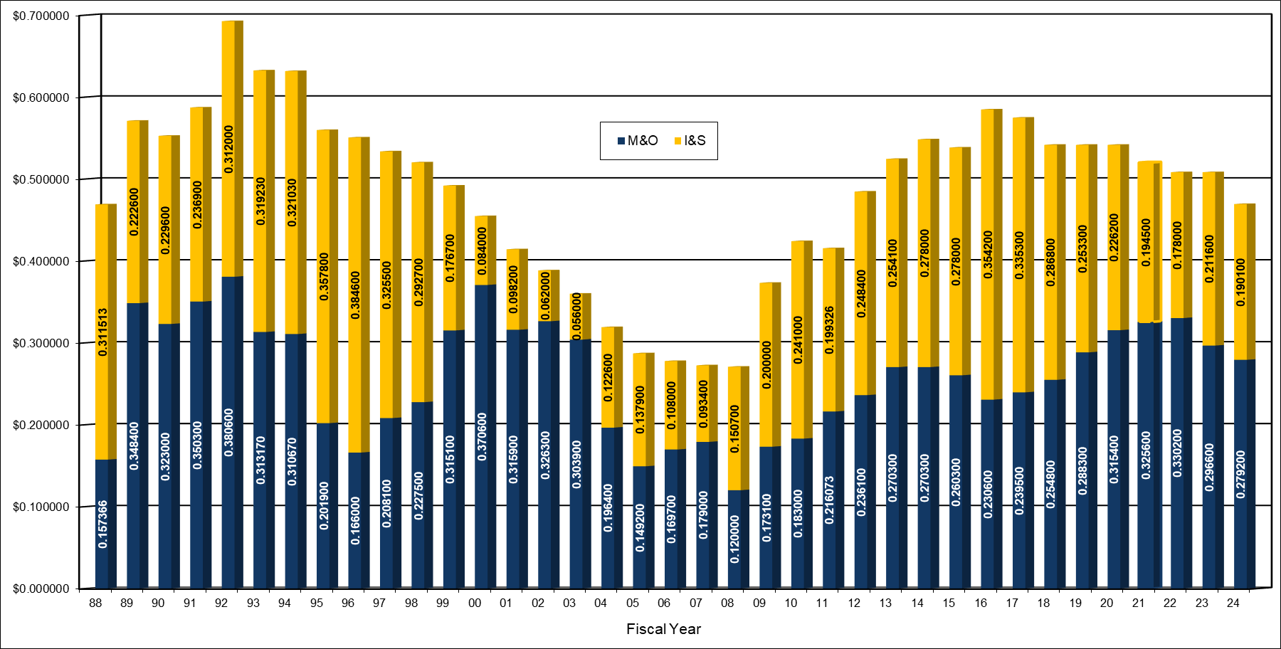
PROPERTY TAX RATE HISTORY
FISCAL YEARS 1988 - 2024

Slide 84
CURRENT PROPERTY TAX RATES IN KYLE - $2.19513
FY 2024-25 Budget
FY 2024-25 Budget

Slide 85
COMPARISON OF
CURRENT PROPERTY TAX RATES
FY 2024-25 Budget

Slide 86
Sales Tax Collections 2008-2025
FY 2024-25 Budget

Slide 87
WATER UTILITY FUND
Proposed Budget Summary &
Highlights
FY 2024-25 Proposed Budget

Slide 88
Key Assumptions
Water Utility Fund
 | FY 2024 | FY 2025 | FY 2026 | FY 2027 | FY 2028 | FY 2029
Water System Revenue Growth | 6.5% | 6.0% | 6.0% | 6.0% | 6.0% | 6.0%
O&M Expenditures | 5.0% | 5.0% | 5.0% | 5.0% | 5.0% | 5.0%
Compensation | 6.0% | 4.5% | 5.0% | 5.0% | 5.0% | 5.0%
Transfer to General Fund | $0.65M | $0.65M | $0.65M | $0.65M | $0.65M | $0.65M
Debt Service | Actual | Actual | Actual | Actual | Actual | Actual
FY 2024-25 Proposed Budget

Slide 89
5-YEAR FORECAST - WATER UTILITY FUND
FISCAL YEARS 2025 THROUGH 2029
(WITHOUT RATE INCREASES)
FY 2024-25 Budget

Slide 90
FUND SUMMARY – WATER UTILITY FUND
PROPOSED BUDGET FISCAL YEAR 2024-25
FY 2024-25 Budget

Slide 91
REVENUE & TRANSFERS-IN - WATER UTILITY FUND
PROPOSED BUDGET FISCAL YEAR 2024-25
$19,522,718
FY 2024-25 Budget
FY 2024-25 Budget

Slide 92
EXPENDITURES & TRANSFERS-OUT - WATER UTILITY FUND
PROPOSED BUDGET FISCAL YEAR 2024-25
$24,445,883
FY 2024-25 Budget
FY 2024-25 Budget

Slide 93
Summary – Water Utility Fund
Proposed Budget Fiscal Year 2024-25
$19.5 million total revenues and transfers-in
$24.4 million total expenditures and transfers-out
  Includes $650,000 equity transfer to General Fund
$9.1 million in estimated ending fund balance
Rate increase (system-wide) projected for water service rates in FY 2025
  Rate increase will vary by customer class
FY 2024-25 Proposed Budget

Slide 94
COMPARISON OF AVERAGE
MONTHLY RESIDENTIAL BILL - WATER
FY 2024-25 Budget

Slide 95
WASTEWATER UTILITY FUND
Proposed Budget Summary &
Highlights
FY 2024-25 Proposed Budget

Slide 96
Key Assumptions
Wastewater Utility Fund
 | FY 2024 | FY 2025 | FY 2026 | FY 2027 | FY 2028 | FY 2029
Wastewater System Revenue Growth | 6.5% | 6.0% | 6.0% | 6.0% | 6.0% | 6.0%
O&M Expenditures | 5.0% | 5.0% | 5.0% | 5.0% | 5.0% | 5.0%
Compensation | 6.0% | 4.5% | 5.0% | 5.0% | 5.0% | 5.0%
Transfer to General Fund | $0.65M | $0.65M | $0.65M | $0.65M | $0.65M | $0.65M
Debt Service | Actual | Actual | Actual | Actual | Actual | Actual
FY 2024-25 Proposed Budget

Slide 97
5-YEAR FORECAST – WASTEWATER UTILITY FUND
FISCAL YEARS 2025 THROUGH 2029
(WITHOUT RATE INCREASES)
FY 2024-25 Budget

Slide 98
FUND SUMMARY – WASTEWATER UTILITY FUND
PROPOSED BUDGET FISCAL YEAR 2024-25
FY 2024-25 Budget

Slide 99
REVENUE & TRANSFERS-IN - WASTEWATER UTILITY FUND
PROPOSED BUDGET FISCAL YEAR 2024-25
$12,272,578
FY 2024-25 Budget
FY 2024-25 Budget

Slide 100
EXPENDITURES & TRANSFERS-OUT - WASTEWATER UTILITY FUND
PROPOSED BUDGET FISCAL YEAR 2024-25
$14,511,876
FY 2024-25 Budget
FY 2024-25 Budget

Slide 101
Summary – Wastewater Utility Fund
Proposed Budget Fiscal Year 2024-25
$12.3 million total revenues and transfers-in
$14.5 million total expenditures and transfers-out
  Includes $650,000 equity transfer to General Fund
$10.9 million in estimated ending fund balance
Rate increase (system-wide) projected for wastewater service rates in FY 2025
  Rate increase will vary by customer class
FY 2024-25 Proposed Budget

Slide 102
COMPARISON OF AVERAGE
MONTHLY RESIDENTIAL BILL - WASTEWATER
FY 2024-25 Budget

Slide 103
STORM DRAINAGE UTILITY FUND
Proposed Budget Summary &
Highlights
FY 2024-25 Proposed Budget

Slide 104
Key Assumptions
Storm Drainage Utility Fund
 | FY 2024 | FY 2025 | FY 2026 | FY 2027 | FY 2028 | FY 2029
Storm Drainage System Revenue Growth | 6.7% | 6.0% | 6.0% | 6.0% | 6.0% | 6.0%
O&M Expenditures | 5.0% | 5.0% | 5.0% | 5.0% | 5.0% | 5.0%
Compensation | 6.0% | 4.5% | 5.0% | 5.0% | 5.0% | 5.0%
Transfer to General Fund | $0.0M | $0.0M | $0.0M | $0.0M | $0.0M | $0.0M
Debt Service | N/A | N/A | N/A | N/A | N/A | N/A
FY 2024-25 Proposed Budget

Slide 105
5-YEAR FORECAST – STORM DRAINAGE UTILITY FUND
FISCAL YEARS 2025 THROUGH 2029
(WITHOUT RATE INCREASES)
FY 2024-25 Budget

Slide 106
FUND SUMMARY – STORM DRAINAGE UTILITY FUND
PROPOSED BUDGET FISCAL YEAR 2024-25
FY 2024-25 Budget

Slide 107
Summary – Storm Drainage Utility Fund
Proposed Budget Fiscal Year 2024-25
$2.3 million total revenues and transfers-in
$2.6 million total expenditures and transfers-out
$518,290 in estimated ending fund balance
No increase proposed for storm drainage fees
FY 2024-25 Proposed Budget

Slide 108
REVENUE & TRANSFERS-IN - STORM DRAINAGE UTILITY FUND
PROPOSED BUDGET FISCAL YEAR 2024-25
$2,251,108
FY 2024-25 Budget
FY 2024-25 Budget

Slide 109
EXPENDITURES & TRANSFERS-OUT - STORM DRAINAGE UTILITY FUND
PROPOSED BUDGET FISCAL YEAR 2024-25
$2,633,358
FY 2024-25 Budget
FY 2024-25 Budget

Slide 110
PROPOSED 5-YEAR
CAPITAL IMPROVEMENTS PLAN (CIP)
FISCAL YEARS 2025 to 2029
FY 2024-25 Proposed Budget

Slide 111
Summary of Proposed 5-Year
Capital Improvements Plan (CIP)
5-Year CIP Spending Plan Covers = FY 2025 to FY 2029
Number of Proposed Projects = 104
Proposed CIP Spending Plan = $848.6 Million
Funded CIP Spending Plan (Estimated) = $476.9 Million or 56.2%
Unfunded CIP Spending Plan (Estimated) = $371.7 Million or 43.8%
 | FY 2025 | FY 2026 | FY 2027 | FY 2028 | FY 2029 | Total
5-Year Spending Plan 2025-2029 | $248.5M | $255.1M | $204.1M | $91.2M | $49.7M | $848.6M
A complete listing of all CIP projects are provided in the budget document.​
FY 2024-25 Proposed Budget
FY 2024-25 Budget

Slide 112
Proposed 5-Year Capital Improvements Plan (CIP)
Fiscal Years 2025-2029 ($ In Millions)
CIP SPENDING CATEGORY | FY 2025 | FY 2026 | FY 2027 | FY 2028 | FY 2029 | Total
1. Park Improvements | $4.5 | $3.6 | $8.1 | $4.3 | $4.5 | $25.0
2. Sportsplex | $7.0 | $21.4 | $20.8 | $15.8 | - | $65.0
3. Vybe Trail System | $0.7 | $1.0 | $1.0 | $1.0 | $1.0 | $4.7
4. 2020 Parks Bond Program | $17.4 | - | - | - | - | $17.4
5. 2022 Road Bond Program | $76.8 | $80.0 | $43.4 | $19.4 | $12.0 | $231.6
6. Streets Improvement Program | $4.8 | $4.9 | $2.9 | $7.9 | $7.9 | $28.3
7. Traffic/Intersection Improvements | $5.2 | $6.2 | $6.2 | $6.2 | $6.2 | $30.0
8. Beautification-Roundabouts/Other | $1.0 | $1.0 | $1.0 | $1.0 | $1.0 | $5.0
9. Rail Siding/Kohlers RR Overpass | $2.6 | - | $6.6 | - | - | $9.2
Continued…
A complete listing of all CIP projects are provided in the budget document.​
FY 2024-25 Proposed Budget
FY 2024-25 Budget

Slide 113
Proposed 5-Year Capital Improvements Plan (CIP)
Fiscal Years 2025-2029 ($ In Millions)
CIP SPENDING CATEGORY | FY 2025 | FY 2026 | FY 2027 | FY 2028 | FY 2029 | Total
10. Property Acquisition Program | $9.5 | $5.0 | $2.0 | $2.0 | $2.0 | $20.5
11. Downtown Redevelopment | - | $1,5 | $1.5 | $1.5 | $1.5 | $6.0
12. Water Utility System | $43.0 | $36.4 | $55.0 | $6.0 | $1.0 | $141.4
13. Wastewater Utility System | $56.6 | $76.7 | $40.2 | $21.2 | $3.7 | $198.2
14. Storm Drainage System | $2.8 | $2.9 | $1.5 | $1.0 | $5.0 | $13.2
15. TIRZ #2 - Roads & Roundabouts | $13.7 | $10.6 | $10.1 | - | - | $34.4
16. TIRZ #6 - Parking Garage | $2.5 | $3.9 | $3.9 | $3.9 | $3.9 | $18.0
17. Miscellaneous/Other | $0.6 | $0.07 | $0.07 | $0.07 | $0.07 | $0.9
18. TOTAL CIP SPENDING PLAN: | $248.5 | $255.1 | $204.1 | $91.2 | $49.7 | $848.6
A complete listing of all CIP projects are provided in the budget document.​
FY 2024-25 Proposed Budget
FY 2024-25 Budget

Slide 114
Proposed 5-Year Capital Improvements Plan (CIP)
Fiscal Years 2025-2029 ($ In Millions)
Funding Source | FY 2025 | FY 2026 | FY 2027 | FY 2028 | FY 2029 | Total
1. General Fund | $13.6 | $8.5 | $5.5 | $10.5 | $10.5 | $48.6
2. Park Development Fund | $4.5 | $3.6 | $8.1 | $4.3 | $4.5 | $25.0
3. Water Utility Fund | $31.0 | $36.4 | $55.0 | $6.0 | $1.0 | $129.4
4. Wastewater Utility Fund | $56.6 | $76.7 | $40.2 | $21.2 | $3.7 | $198.2
5. Storm Drainage Utility Fund | $2.8 | $2.9 | $1.5 | $1.0 | $5.0 | $13.2
6. Street Improvement Fund | $1.9 | $3.9 | $1.9 | $1.9 | $1.9 | $11.4
7. Transportation Fund | $2.6 | $0.0 | $6.6 | $0.0 | $0.0 | $9.2
8. TIRZ #2 Fund | $13.7 | $10.6 | $10.1 | $0.0 | $0.0 | $34.4
9. TIRZ #6 Fund | $2.5 | $3.9 | $3.9 | $3.9 | $3.9 | $18.0
Continued…
A complete listing of all CIP projects are provided in the budget document.​
FY 2024-25 Proposed Budget
FY 2024-25 Budget

Slide 115
Proposed 5-Year Capital Improvements Plan
(CIP) Fiscal Years 2025-2029 ($ In Millions)
Funding Source | FY 2025 | FY 2026 | FY 2027 | FY 2028 | FY 2029 | Total
10. HOT Fund | $0.07 | $0.07 | $0.07 | $0.07 | $0.07 | $0.4
11. ARPA Grant Fund | $12.0 | - | - | - | - | $12.0
12. 2020 GO Bond Fund (Parks) | $8.7 | - | - | - | - | $8.7
13. County’s Matching Funds (Parks) | $8.7 | - | - | - | - | $8.7
14. 2022 GO Bond Fund (Roads) | $76.8 | $80.0 | $43.4 | $19.4 | $12.0 | $231.6
15. Future Bonds | $13.2 | $28.6 | $28.0 | $23.0 | $7.2 | $100.0
5-Year Spending Plan 2025-2029 | $248.5 | $255.1 | $204.1 | $91.2 | $49.7 | $848.6
A complete listing of all CIP projects are provided in the budget document.​
FY 2024-25 Proposed Budget
FY 2024-25 Budget

Slide 116
TOTAL OUTSTANDING BOND DEBT
Current & Projected Debt
By Repayment Source
FY 2024-25 Proposed Budget

Slide 117
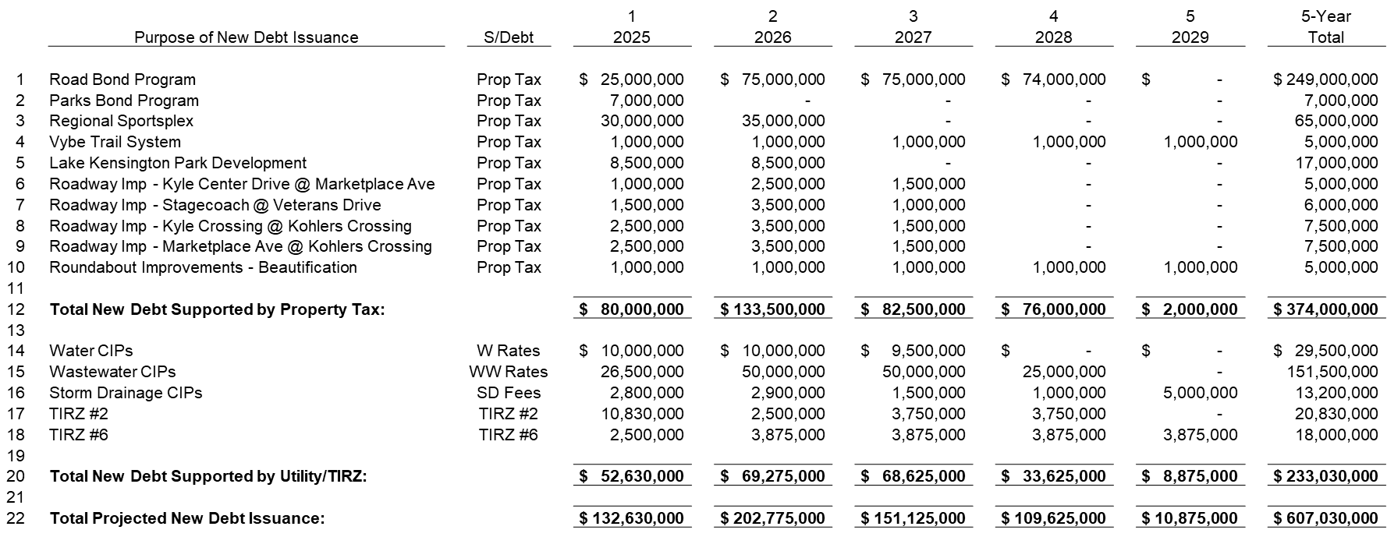
5-YEAR FORECAST OF NEW BOND ISSUANCES
FISCAL YEARS 2025 THROUGH 2029
FY 2024-25 Budget

Slide 118
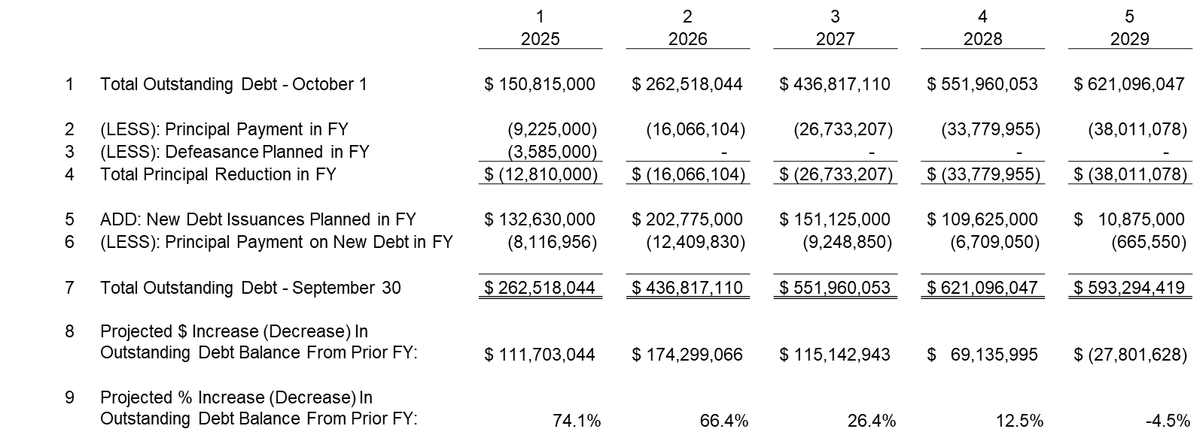
5-YEAR FORECAST OF CITY’S BOND DEBT POSITION
FISCAL YEARS 2025 THROUGH 2029
FY 2024-25 Budget

Slide 119
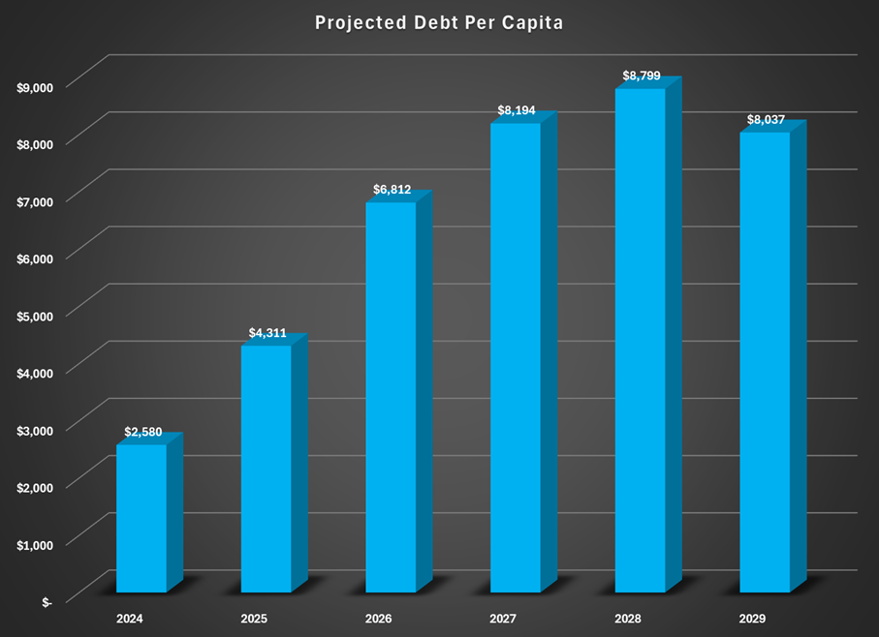
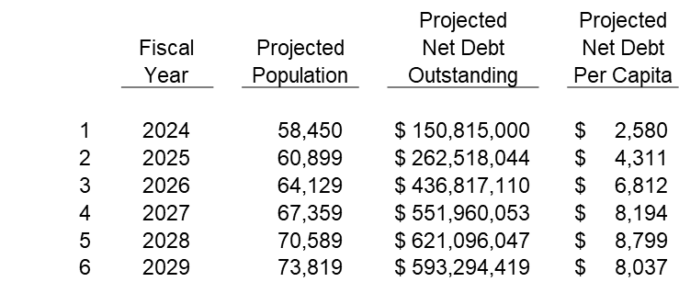
5-YEAR FORECAST OF CITY’S DEBT PER CAPITA
FISCAL YEARS 2025 THROUGH 2029
FY 2024-25 Budget
FY 2024-25 Budget

Slide 120
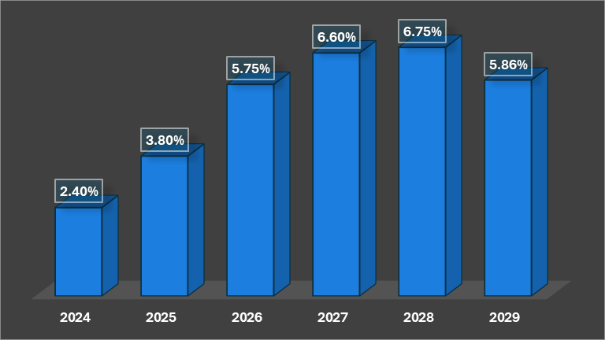
5-YEAR FORECAST OF CITY’S DEBT AS % OF AV
FISCAL YEARS 2025 THROUGH 2029
FY 2024-25 Budget
FY 2024-25 Budget

Slide 121
PROPOSED FEES & RATES
Proposed Budget
Fiscal Year 2024-25
FY 2024-25 Budget

Slide 122
Proposed New Fees & Changes
Fiscal Year 2024-25
Total Number of Fees & Charges = 479
Number of New Fees Proposed = 34
Number of Fees/Charges Unchanged = 276
Number of Fees Changed = 39 (33 Increased & 6 Decreased)
Number of Rate Changes Pending = 130 (Water & Wastewater Rates)
A complete listing of all Fees & Charges are provided in the budget document.
FY 2024-25 Budget

Slide 123
ALL OTHER CITY FUNDS
Proposed Budget
Fiscal Year 2024-25
FY 2024-25 Budget

Slide 124
All Other City Funds (53)
$261,197,758 Total Proposed Expenditures For All 53 Other City Funds ​
Examples of Other City Funds include:​
Debt Service Fund |  | $ 11,793,135
TIRZ #1 Fund |  | $ 1,790,869
TIRZ #2 Fund |  | $ 15,010,898
Park Development Fund |  | $ 4,686,000
General Fund CIP |  | $ 10,580,000
Storm Drainage CIP Fund |  | $ 2,800,000
Street Improvement Fund |  | $ 1,880,000
Transportation Fund |  | $ 2,600,000
American Rescue Plan Act Fund |  | $ 12,000,000
Water Impact Fee Fund |  | $ 30,985,045
Wastewater Impact Fee Fund |  | $ 46,062,230
Future Bond Fund |  | $ 13,200,000
2020 GO Bond Fund |  | $ 17,363,837
2022 GO Bond Fund |  | $ 76,803,146
A complete listing of all other City Funds and expenditure details are provided in the budget document.​
FY 2024-25 Budget
FY 2024-25 Proposed Budget
FY 2023-2024 Sales Tax Collections

Slide 125
Next Steps
Saturday, July 27, 2024
  City Manager's Presentation of Proposed Budget for FY 2024-2025
  City Fees & Charges Overview
Tuesday, August 6, 2024
  Launch of Performance Measurement & Lean Government Initiatives
  Water and Wastewater - Cost of Service Study & Rates
  Property Tax Rate Calculations From Hays County Tax Assessor-Collector (HCTAC)
Tuesday, August 20, 2024
  Economic Development Master Plan
  Public Hearing - Budget, Fees, Utility Rates, & Property Tax Rates
  1st Reading: Budget Adoption Ordinance
  1st Reading: Property Tax Rate Adoption Ordinance
FY 2024-25 Proposed Budget

Slide 126
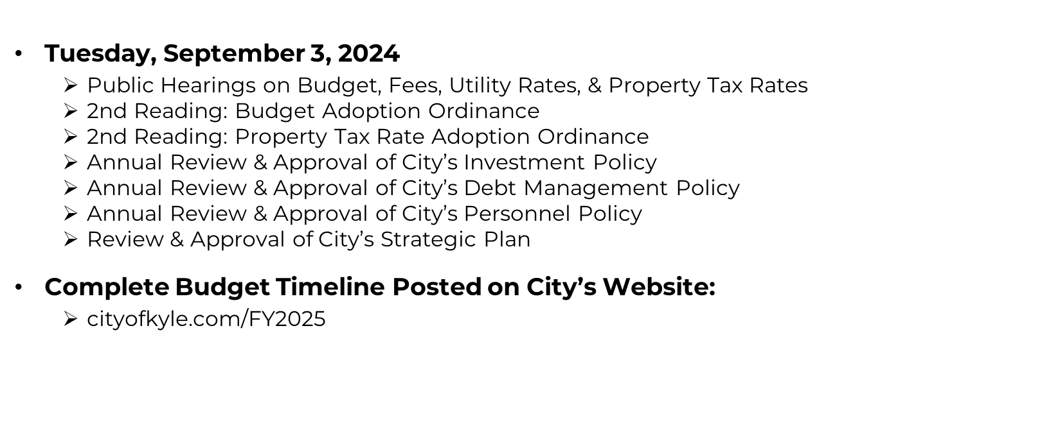
Next Steps (Continued)
FY 2024-25 Budget

Slide 127
CITY COUNCIL
Proposed Budget & Options
Fiscal Year 2024-25
FY 2024-25 Budget

Slide 128
Proposed Budget – City Council
FY 2024-25
  City Council Directed Staff To Review Past Council Line-Item Expenditures & Bring Back Budget Options For Next Fiscal Year.
  Four (4) Budget Options Developed For Council’s Consideration For FY 2025.
  Option 1:
  Same As Current Approved Budget Except For Legal & Computer Hardware.
  Option 2:
  Based On A 2-Year Average of Actual Expenditures For FY 2022 & FY 2023.
  Option 3:
  Based On A 1-Year Annualized Average of Actual Expenditures For FY 2024.
  Option 4:
  Hybrid Of Options 1, 2, & 3 (Rounded).
FY 2024-25 Budget

Slide 129
Proposed Budget Summary – City Council
FY 2024-25
FY 2024-25 Budget

Slide 130
Options - City Council’s Budget (Summary)
FY 2024-25
FY 2024-25 Budget

Slide 131
Options - Council Budget (Support Cost Line-Items)
FY 2024-25
FY 2024-25 Budget

Slide 132
Proposed Budget – City Council FY 2024-25
Direction To Staff Regarding City Council’s Budget For Next Fiscal Year 2025.
  Option 1: Same As Current Approved Budget
  Option 2: 2-Year Average of Actual Expenditures For FY 2022 & FY 2023
  Option 3: 1-Year Annualized Average of Actual Expenditures For FY 2024
  Option 4: Hybrid Of Options 1, 2, & 3 (Rounded).
  Other Options?
FY 2024-25 Budget

Slide 133
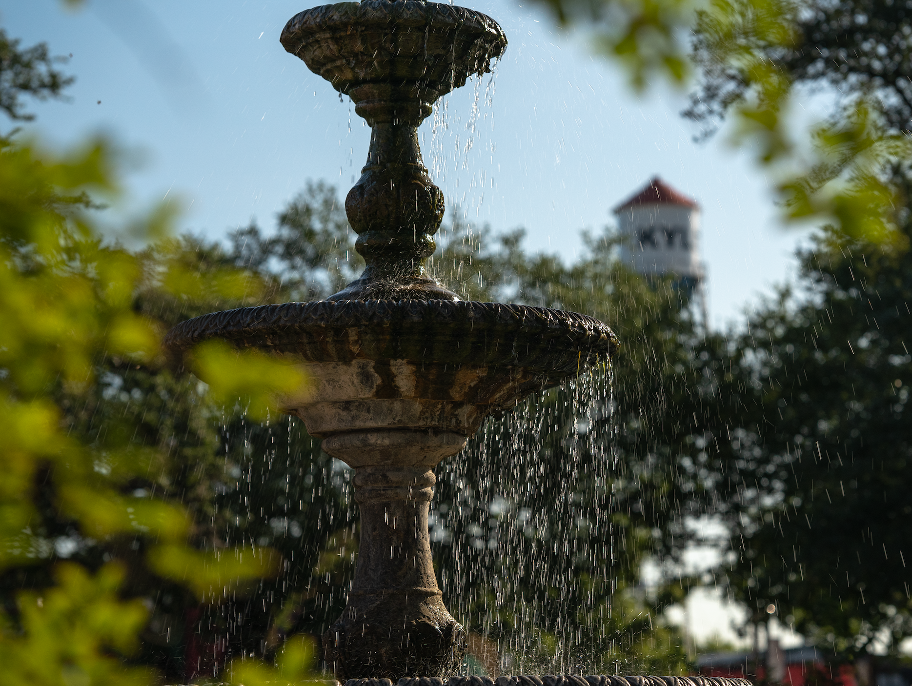
City Council’s Budget
Priorities & Direction
Are City Council’s Priority Programs & Services Included in the Proposed Budget for FY 2025?
Are City Council’s Priority Capital Improvement Projects (CIPs) Included in the Proposed Budget for FY 2025?
Any Other Budget Related Items or Direction to City Manager Pertaining to the Proposed Budget for FY 2025?
FY 2024-25 Budget

